Slide 1


Day 11
Math24 (Differential Equations)
Ch 2.5 Autonomous Equations and Population Dynamics (Page 78-95)
Elementary Differential Equations and Boundary Value Problems, 10th edition, by William E. Boyce and Richard C. DiPrima, ©2013 by John Wiley & Sons, Inc.

Slide 2
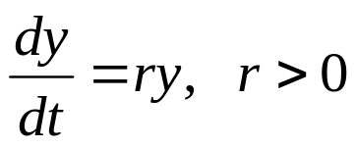
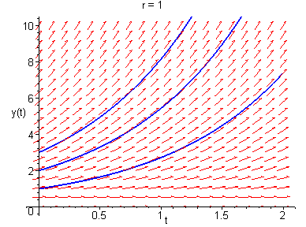
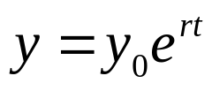
In this section we examine equations of the form dy/dt = f (y), called autonomous equations, where the independent variable t does not appear explicitly.
The main purpose of this section is to learn how geometric methods can be used to obtain qualitative information directly from differential equation without solving it.
Example (Exponential Growth):
Solution:

Slide 3
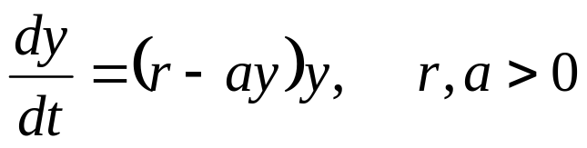
Logistic Growth
An exponential model y' = ry, with solution y = e^{rt}, predicts unlimited growth, with rate r > 0 independent of population.
Assuming instead that growth rate depends on population size, replace r by a function h(y) to obtain dy/dt = h(y)y.
We want to choose growth rate h(y) so that
  h(y) ≅ r when y is small,
  h(y) decreases as y grows larger, and
  h(y) < 0 when y is sufficiently large.
The simplest such function is h(y) = r – ay, where a > 0.
Our differential equation then becomes
This equation is known as the Verhulst, or logistic, equation.

Slide 4
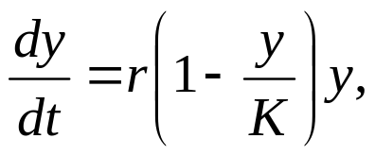
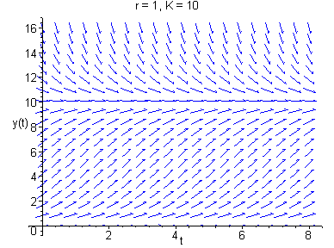
Logistic Equation
The logistic equation from the previous slide is
This equation is often rewritten in the equivalent form
where K = r/a. The constant r is called the intrinsic growth rate, and as we will see, K represents the carrying capacity of the population.
A direction field for the logistic
equation with r = 1 and K = 10
is given here.

Slide 5
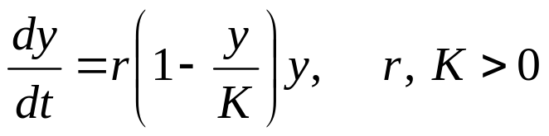


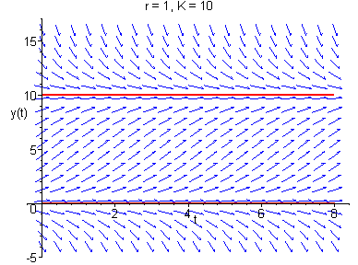
Logistic Equation: Equilibrium Solutions
Our logistic equation is
Two equilibrium solutions are clearly present:
In direction field below, with r = 1, K = 10, note behavior of solutions near equilibrium solutions:
y = 0 is unstable,
y = 10 is asymptotically stable.

Slide 6
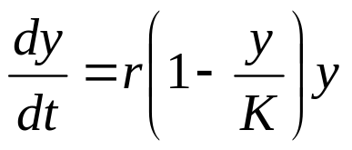
Autonomous Equations: Equilibrium Solns
Equilibrium solutions of a general first order autonomous equation y' = f (y) can be found by locating roots of f (y) = 0.
These roots of f (y) are called critical points.
For example, the critical points of the logistic equation
are y = 0 and y = K.
Thus critical points are constant
functions (equilibrium solutions)
in this setting.

Slide 7
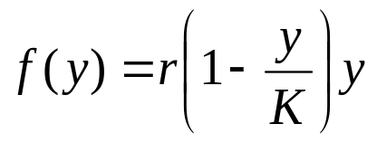
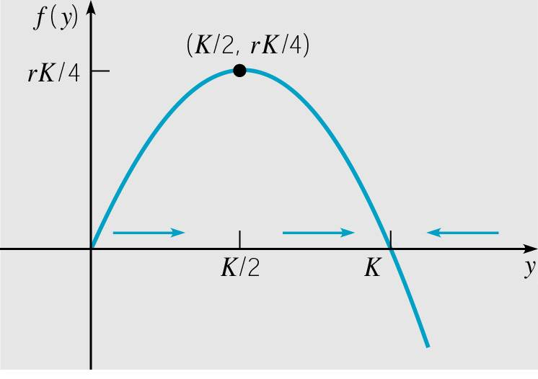
Logistic Equation: Qualitative Analysis and Curve Sketching (1 of 7)
To better understand the nature of solutions to autonomous equations, we start by graphing f (y) vs. y.
In the case of logistic growth, that means graphing the following function and analyzing its graph using calculus.

Slide 8
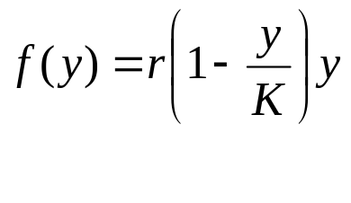
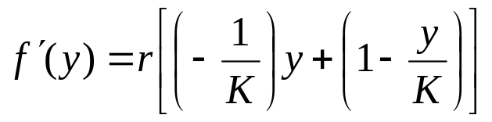
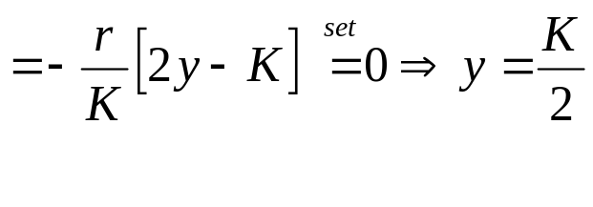
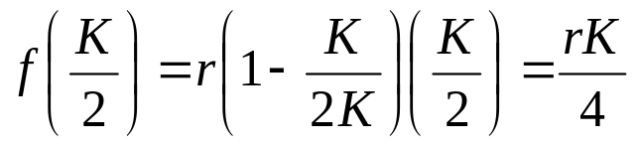
Logistic Equation: Critical Points (2 of 7)
The intercepts of f occur at y = 0 and y = K, corresponding to the critical points of logistic equation.
The vertex of the parabola is (K/2, rK/4), as shown below.

Slide 9
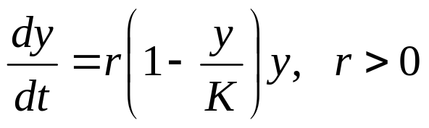
Logistic Solution: Increasing, Decreasing (3 of 7)
Note dy/dt > 0 for 0 < y < K, so y is an increasing function of t there (indicate with right arrows along y-axis on 0 < y < K).
Similarly, y is a decreasing function of t for y > K (indicate with left arrows along y-axis on y > K).
In this context the y-axis is often called the phase line.

Slide 10

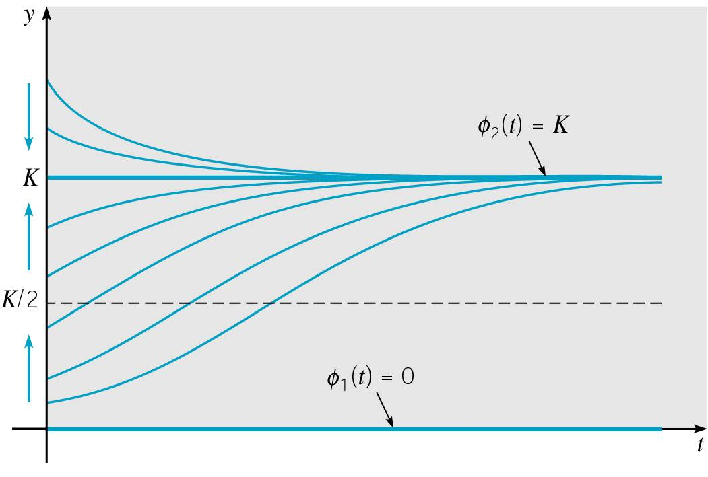
Logistic Solution: Steepness, Flatness (4 of 7)
Note dy/dt ≅ 0 when y ≅ 0 or y ≅ K, so y is relatively flat there, and y gets steep as y moves away from 0 or K.

Slide 11
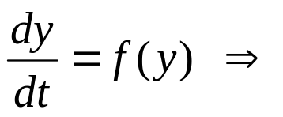
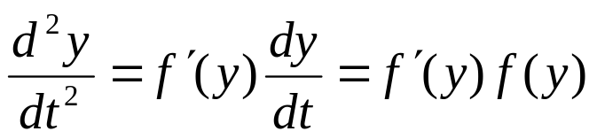
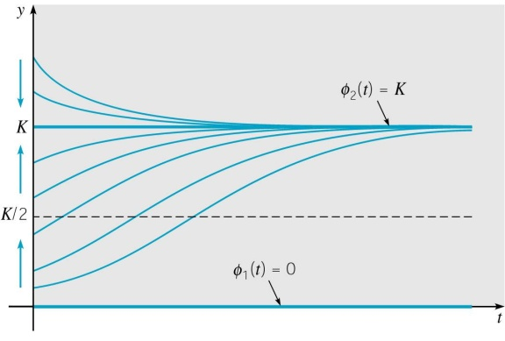
Logistic Solution: Concavity (5 of 7)
Next, to examine concavity of y(t), we find y'':
Thus the graph of y is concave up when f and f ' have same sign, which occurs when 0 < y < K/2 and y > K.
The graph of y is concave down when f and f ' have opposite signs, which occurs when K/2 < y < K.
Inflection point occurs at intersection of y and line y = K/2.

Slide 12
Logistic Solution: Curve Sketching (6 of 7)
Combining the information on the previous slides, we have:
  Graph of y increasing when 0 < y < K.
  Graph of y decreasing when y > K.
  Slope of y approximately zero when y ≅ 0 or y ≅ K.
  Graph of y concave up when 0 < y < K/2 and y > K.
  Graph of y concave down when K/2 < y < K.
  Inflection point when y = K/2.
Using this information, we can
sketch solution curves y for
different initial conditions.

Slide 13
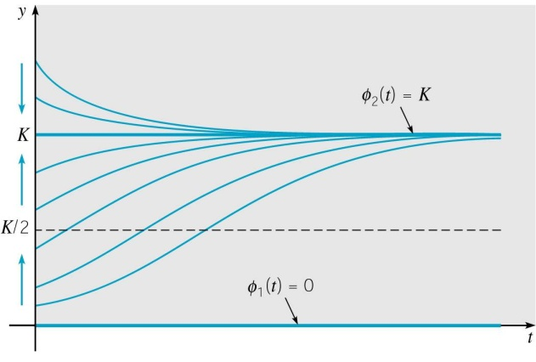
Logistic Solution: Discussion (7 of 7)
Using only the information present in the differential equation and without solving it, we obtained qualitative information about the solution y.
For example, we know where the graph of y is the steepest, and hence where y changes most rapidly. Also, y tends asymptotically to the line y = K, for large t.
The value of K is known as the carrying capacity, or saturation level, for the species.
Note how solution behavior differs
from that of exponential equation,
and thus the decisive effect of
nonlinear term in logistic equation.

Slide 14
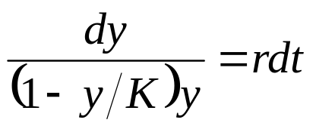
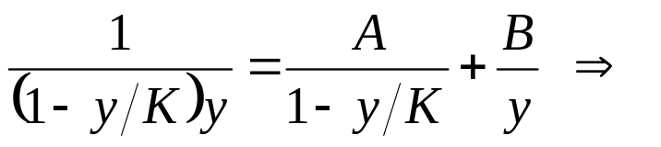


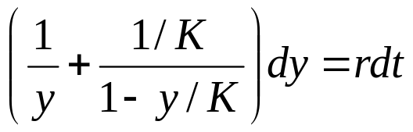
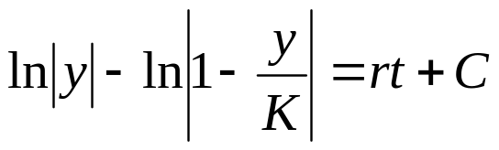
Solving the Logistic Equation (1 of 3)
Provided y ≠ 0 and y ≠ K, we can rewrite the logistic ODE:
Expanding the left side using partial fractions,
Thus the logistic equation can be rewritten as
Integrating the above result, we obtain

Slide 15
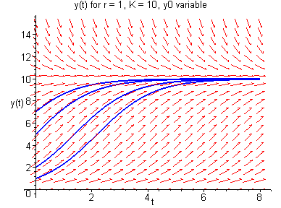
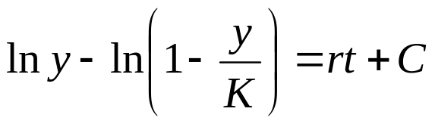
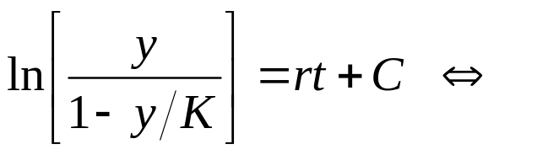
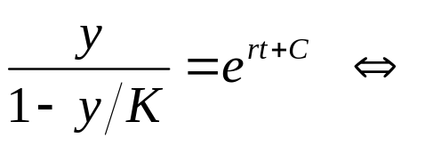
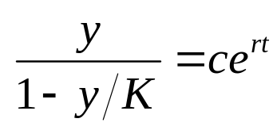
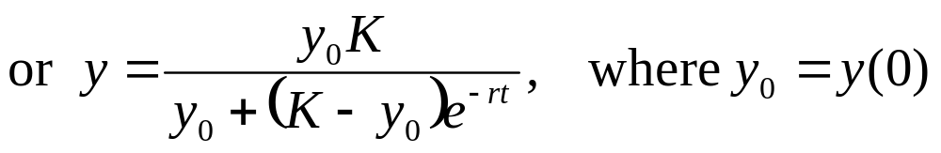
Solving the Logistic Equation (2 of 3)
We have:
If 0 < y₀ < K, then 0 < y < K and hence
Rewriting, using properties of logs:

Slide 16
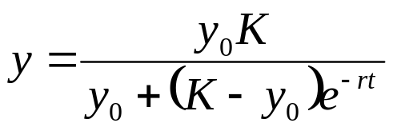
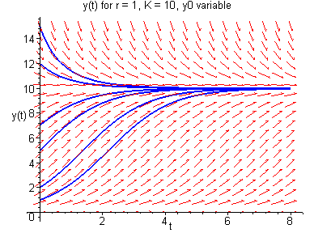
Solution of the Logistic Equation (3 of 3)
We have:
for 0 < y₀ < K.
It can be shown that solution is also valid for y₀ > K. Also, this solution contains equilibrium solutions y = 0 and y = K.
Hence solution to logistic equation is

Slide 17
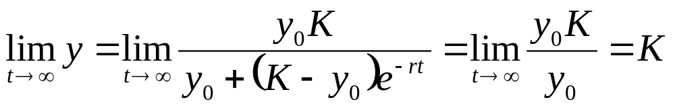
Logistic Solution: Asymptotic Behavior
The solution to logistic ODE is
We use limits to confirm asymptotic behavior of solution:
Thus we can conclude that the equilibrium solution y(t) = K is asymptotically stable, while equilibrium solution y(t) = 0 is unstable.
The only way to guarantee solution remains near zero is to make y₀ = 0.

Slide 18
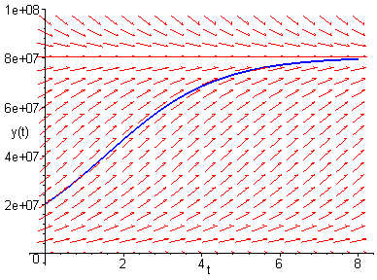
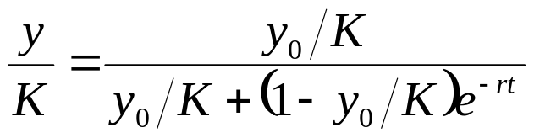
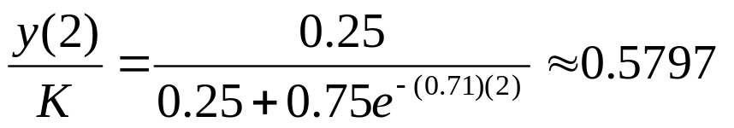
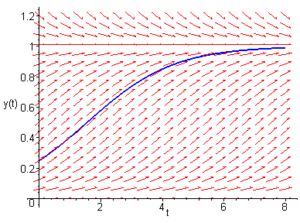

Example 1: Pacific Halibut (1 of 2)
Let y be biomass (in kg) of halibut population at time t, with r = 0.71/year and K = 80.5 x 10⁶ kg. If y₀ = 0.25K, find
  (a) biomass 2 years later
  (b) the time τ such that y(τ) = 0.75K.
(a) For convenience, scale equation:
Then
and hence

Slide 19
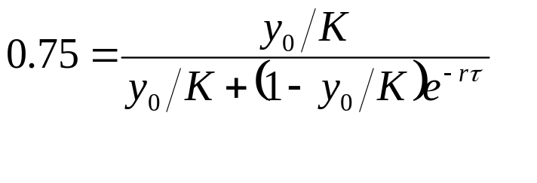
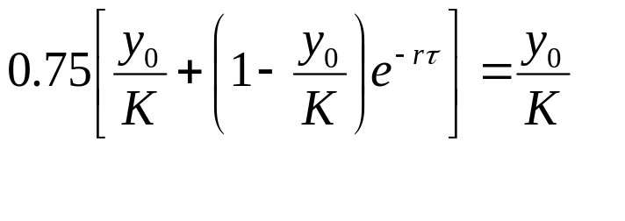

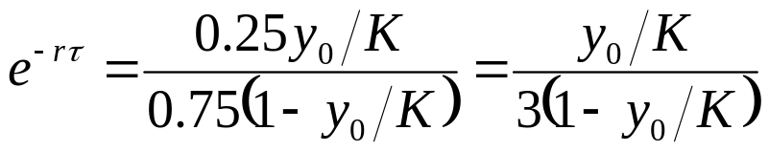
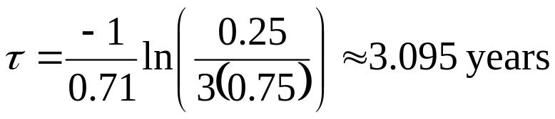
Example 1: Pacific Halibut, Part (b) (2 of 2)
(b) Find time τ for which y(τ) = 0.75K.

Slide 20
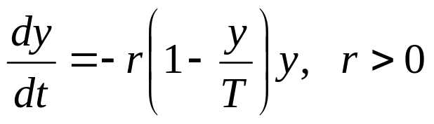
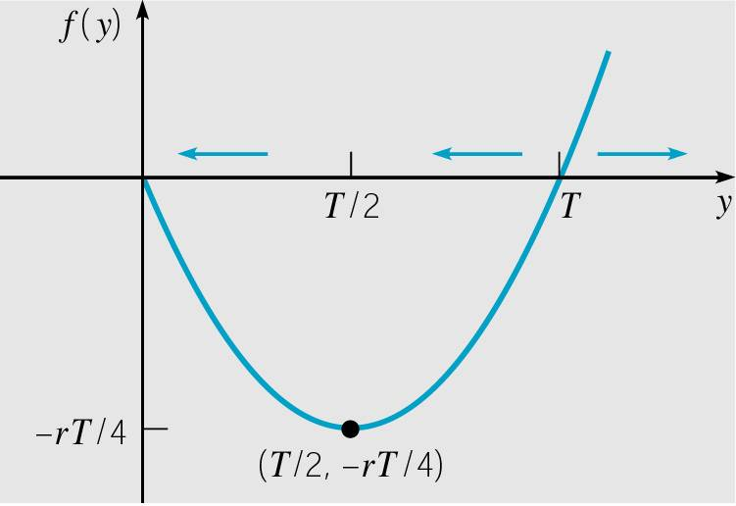
Critical Threshold Equation (1 of 2)
Consider the following modification of the logistic ODE:
The graph of the right hand side f (y) is given below.

Slide 21
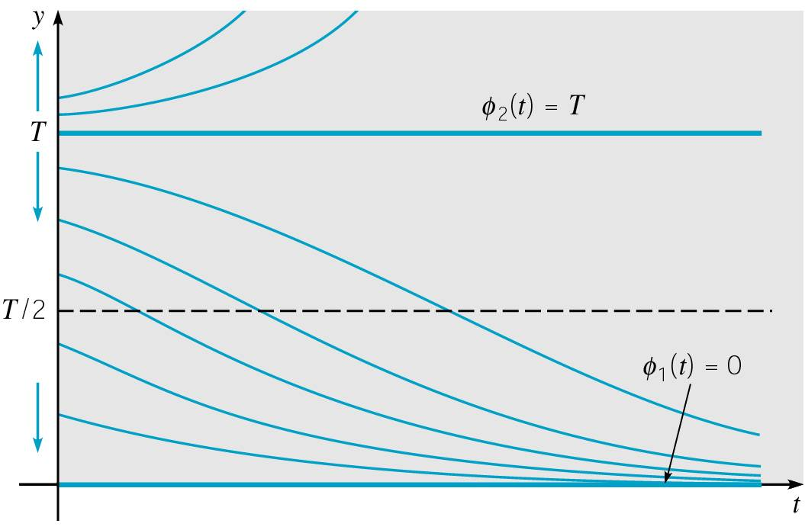
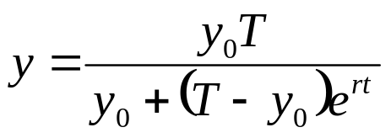
Critical Threshold Equation: Qualitative Analysis and Solution (2 of 2)
Performing an analysis similar to that of the logistic case, we obtain a graph of solution curves shown below.
T is a threshold value for y₀, in that population dies off or grows unbounded, depending on which side of T the initial value y₀ is.
See also laminar flow discussion in text.
It can be shown that the solution to the threshold equation
is

Slide 22
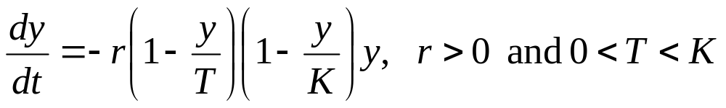
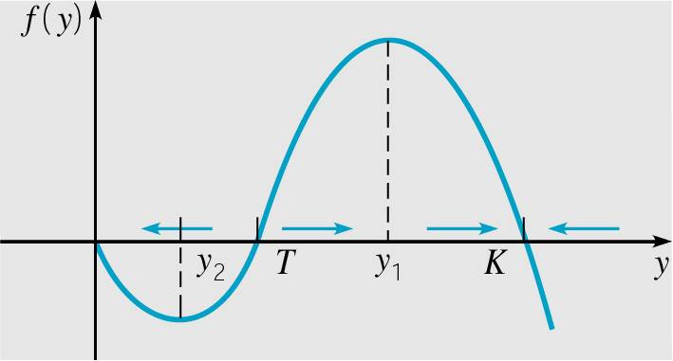
Logistic Growth with a Threshold (1 of 2)
In order to avoid unbounded growth for y > T as in previous setting, consider the following modification of the logistic equation:
The graph of the right hand side f (y) is given below.

Slide 23
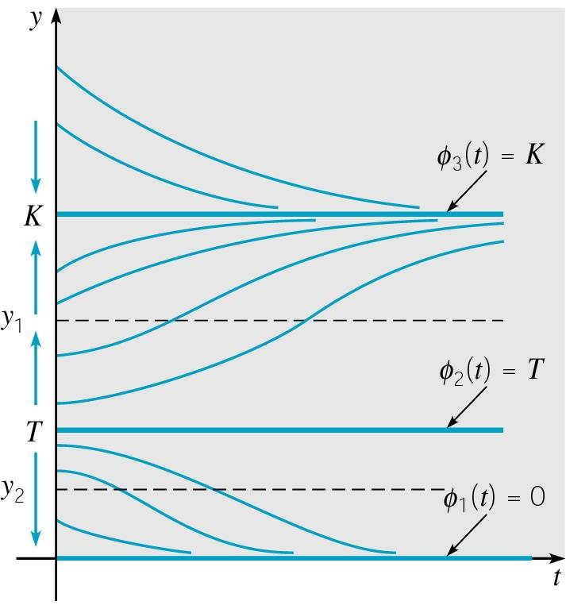
Logistic Growth with a Threshold (2 of 2)
Performing an analysis similar to that of the logistic case, we obtain a graph of solution curves shown below right.
T is threshold value for y₀, in that population dies off or grows towards K, depending on which side of T y₀ is.
K is the carrying capacity level.
Note: y = 0 and y = K are stable equilibrium solutions,
and y = T is an unstable equilibrium solution.

